Slide 1



Semi-Static Network Routing
Joel Smith
Jadante Hendrick
Pamir Ahmad

Slide 2
Introduction
Analyze the potential for simple adaptive measures to allow for simple dynamic changes to static routing algorithms

Slide 3
Static Routing
Static routing is a type of routing where the routing table is manually set by the network administrator
This type of routing is easy to design and implement as it doesn't use complex algorithms
Static routing requires less resources compared to dynamic routing
Static routing provides more security than dynamic routing

Slide 4
Issues with Static Routing
The biggest issue with static routing is that the routing table must be manually updated.
Cannot use complex routing algorithms that help when working with a large network
Link failure can disrupt routing due to the table not being able to dynamically update and reroute traffic
Very inefficient to have static routing in a large network

Slide 5
Dynamic Routing
Dynamic routing is a type of routing where the routing table is automatically updated by routing protocols and complex algorithms.
It is much easier to make changes in the topology compared to static routing.
A failure in a link will not interrupt rerouting since it will find another path unlike static routing

Slide 6
Issues with Dynamic routing
It is only efficient in medium to large networks so setting it up for a small network would be too time consuming
Dynamic routing does not provide high security features that static routing does
Additional resources are required when setting up dynamic routing for a topology compared to static routing

Slide 7
Problem
Static routing does not allow for the network to adapt to stresses of message transmission causing higher packet loss with a relatively short run time since it does not re-evaluate the path between source and destination.
Static
Dynamic routing has a much higher overhead cost due to the network deciding at every node which path the packet is to take thus reducing the number of packets dropped and increasing runtime.
Dynamic

Slide 8
Solution: Semi-Static Routing
Provides the central control of the network's routing while offering adaptive response to stressed networks.
The base routing within the network is implemented by Dijkstra's Shortest Path Algorithm.
The Semi-Static adaptive part of the routing implementation is accomplished by rerouting (using Dijkstra's algorithm) using the current snapshots of the graph and the queues for each of the nodes.

Slide 9
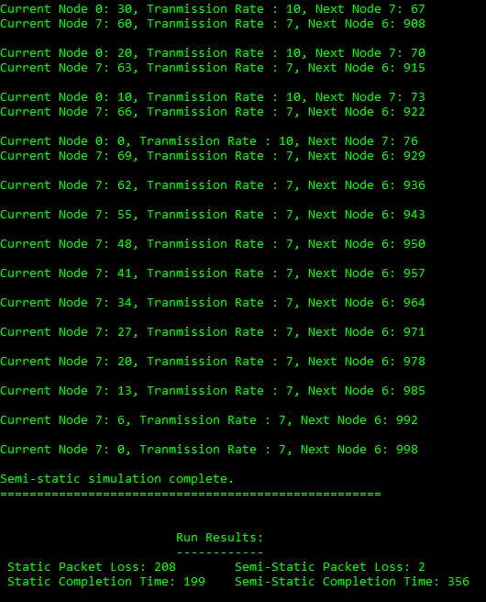
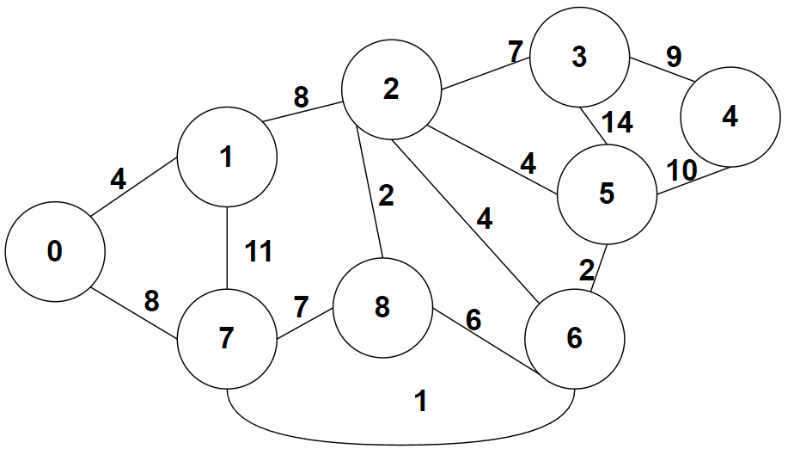
Simulation Run Comparisons
Graph:
Node Queues (Source: 0, Destination: 6):
[1000 100 50 70 45 80 1000 100 90]
Node Transmission Rates:
[10 8 12 9 7 10 6 7 13]
GitHub Simulation Code

Slide 10
Results
Semi-static routing reduces the number of dropped packets by adapting to the conditions of the network to redirect packets to a new path when a packet is dropped by the network.
Semi-static routing does have a longer run time due to the non-multithreaded environment as well as the higher overhead cost of rerouting for the new shortest path.

Slide 11
Future Work
Improve
Improve simulation to provide multithreaded environment for a more accurate set of data between static and semi-static routing
Expand
Expand to analyze multi-source networks and multi-destination packet transmission
Provide
Provide detailed comparison between Semi-static and dynamic routing algorithms

Slide 12
Conclusion
Based on the above simulation and comparison of what Semi-static routing has to offer, Semi-static routing provides reasonable efficiency for small to medium networks.
The adaptive feature of the purposed routing algorithm requires further analysis on varying graphs and networking situations to better gauge usability

Slide 13
Sources
Static routing vs Dynamic Routing: Top 10 differences you should know. EDUCBA. (2021, March 16). Retrieved December 1, 2021, from https://www.educba.com/static-routing-vs-dynamic-routing/.
Deepali and Padmavati. Improved Energy Efficiency semi static routing algorithm using sink mobility for WSNs. IEEE Xplore. (2014, March 8). https://ieexplore.ieee.org/stamp/stamp.jsp?tp=&arnumber=6799602.
Advantages of dynamic routing over static routing : Advertise only the directly connected networks. updates the topology changes dynamically. administrative. - ppt download. SlidePlayer. (n.d.). Retrieved December 2, 2021, from https://slideplayer.com/slide/6923610/.
Difference between static and dynamic routing. GeeksforGeeks. (2020, June 15). Retrieved December 2, 2021, from https://www.geeksforgeeks.org/difference-between-static-and-dynamic-routing/.

